Slide 1
Physiotherapy and health promotion

Slide 2
By the end of this lecture you should
Describe how physiotherapists contribute to health promotion and prevention across common conditions relevant to their practice (e.g. MSK, respiratory, LTCs).
Explain what HCPC SoP 15.1–15.3 require of physiotherapists in relation to public health and behaviour change.
Identify how CSP frames physiotherapists as part of the wider public health workforce, including links to the Public Health Skills and Knowledge Framework (PHSKF).​
Apply the Making Every Contact Count (MECC) idea to simple physiotherapy case scenarios and outline a brief health‑promoting conversation they could have.

Slide 3
Where this fits in the module
This session builds on your SDL task on physiotherapists and public health.
It links to earlier sessions
It prepares you for clinical placements and your assessment and reflective practice (contemporary practice, HCPC/CSP, communication).

Slide 4
SDL recap
You explored examples of physiotherapists acting in ways that promote health or prevent ill health.
You identified settings (e.g. MSK, respiratory, neuro, community) where physios influence population health.
You generated questions about what “counts” as public health in physiotherapy.

Slide 5
SDL recap: Pair-share
Instructions:
Turn to the person next to you.
Share:
  One example from your SDL where a physio contributed to public health.
  One question you still have about the physio–public health role e.g.
  “What are physios already doing that looks like public health?”
Post your insights on the padlet

Slide 6


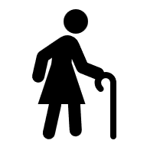

Why talk about Public health in Physio
Modifiable risk factors and their influence on long term conditions
Physiotherapy setting and opportunity
Ageing population
Physiotherapy skills
Notes:
Major causes of illness/disability (low back pain, OA, COPD, stroke) are strongly influenced by modifiable risk factors: physical inactivity (28% of UK adults inactive), smoking, obesity, alcohol.​
Physiotherapists routinely work with these conditions across multiple contacts/settings, giving repeated opportunities to address risk factors as part of normal care.​
Health services face rising multimorbidity/ageing population pressure – all clinicians, including physios, expected to contribute to prevention/health promotion.​
Your skills (exercise prescription, education, behaviour change, self-management) are central to tackling these public-health challenges

Slide 7
Examples from practice: MSK Practice
Low back pain
Long term sickness. Chronic inactivity
Physiotherapy intervention :
- Therapy
-Behaviour change
-Education
Patient avoids movement.
Promote return to work and create sustainable plan to support normal function
Notes:
MSK outpatient: Recurrent low back pain patient avoiding movement/off work long-term → beyond manual therapy/exercises, address pain beliefs, promote staying active, explore return-to-work support, signpost community PA options.​
Pulmonary rehab: COPD group → combine exercise training with smoking cessation support, breathing/pacing education, vaccines → lowers exacerbation risk.​
Neuro/older adults: Post-stroke or frequent falls → strength/balance training, environmental modifications, confidence building → reduces hospital admissions.

Slide 8
Patient Examples: Resp
COPD patient with breathlessness
Avoiding activity, worsening function, anxiety towards exercise
Pulmonary rehab :
- Education
-Exercise
-Smoking cessation referral
-Reinforce health beliefs
Improved function and self-management
Reduced breathlessness and exacerbation risk
Notes:
Pulmonary rehab: COPD group → combine exercise training with smoking cessation support, breathing/pacing education, vaccines → lowers exacerbation risk.​

Slide 9

Prevention across levels
Primary care
  Stop before it starts
Secondary care
  Early intervention
Tertiary care
  Reduce impact
Notes:
Primary (stop before starts): workplace ergonomics reducing back injuries; community exercise for diabetes/CVD risk; walking/cycling campaigns.​
Secondary (early intervention): early MSK access prevents chronicity; breathlessness → pulmonary rehab referral; falls risk screening.​
Tertiary (reduce impact): stroke rehab maximising independence; COPD/heart failure management; chronic pain programmes reducing disability.

Slide 10

“not an add-on”
Should be a routine part of EVERY consultation
Ignoring major risk factors can lead to poor outcomes
HCPC SOP 15.1-15.3
Notes:
"Public health" happens in routine consultations – asking about activity/smoking/falls risk, helping set goals, signposting local support = legitimate physiotherapy.​
Ignoring major risk factors (smoking in COPD, inactivity in diabetes+OA) compromises rehab outcomes, hard to justify professionally.​
HCPC SoP 15.1-15.3 + CSP health inequalities emphasis = regulatory/professional mandate.

Slide 11
Reflection question
In pairs :
  Last placement/simulation: identify a moment where brief conversation could've influenced health behaviour? What stopped it/what helped?“
  Discuss with your partner

Slide 12
Why it matters
Physiotherapy interventions:
  Brief advice
  Behaviour change
  Integrated health promotion
Results:
  Pain reduction
  Functional improvements
  Reduced sick leave
  Improved outcomes
Notes:
Physiotherapy‑led public health interventions, such as brief advice on behaviour change and integrated health promotion, show consistent positive effects on patient outcomes like pain reduction, functional improvement and reduced sick leave.

Slide 13
Brief advice CAN make a difference
Short consultations on smoking or physical activity increase:
  Quit attempts and successful quitting
  The proportion of adults reaching physical‑activity recommendations
The key: advice is specific, structured and behaviour‑focused, not just “you should be healthier”

Slide 14

Why it matters
Physios regularly see people with pain, long‑term conditions and pre/post surgery.
A brief but well‑timed conversation about smoking, activity, weight or alcohol can:
  Trigger meaningful behaviour change
  Enhance the impact of the physical treatment you provide

Slide 15
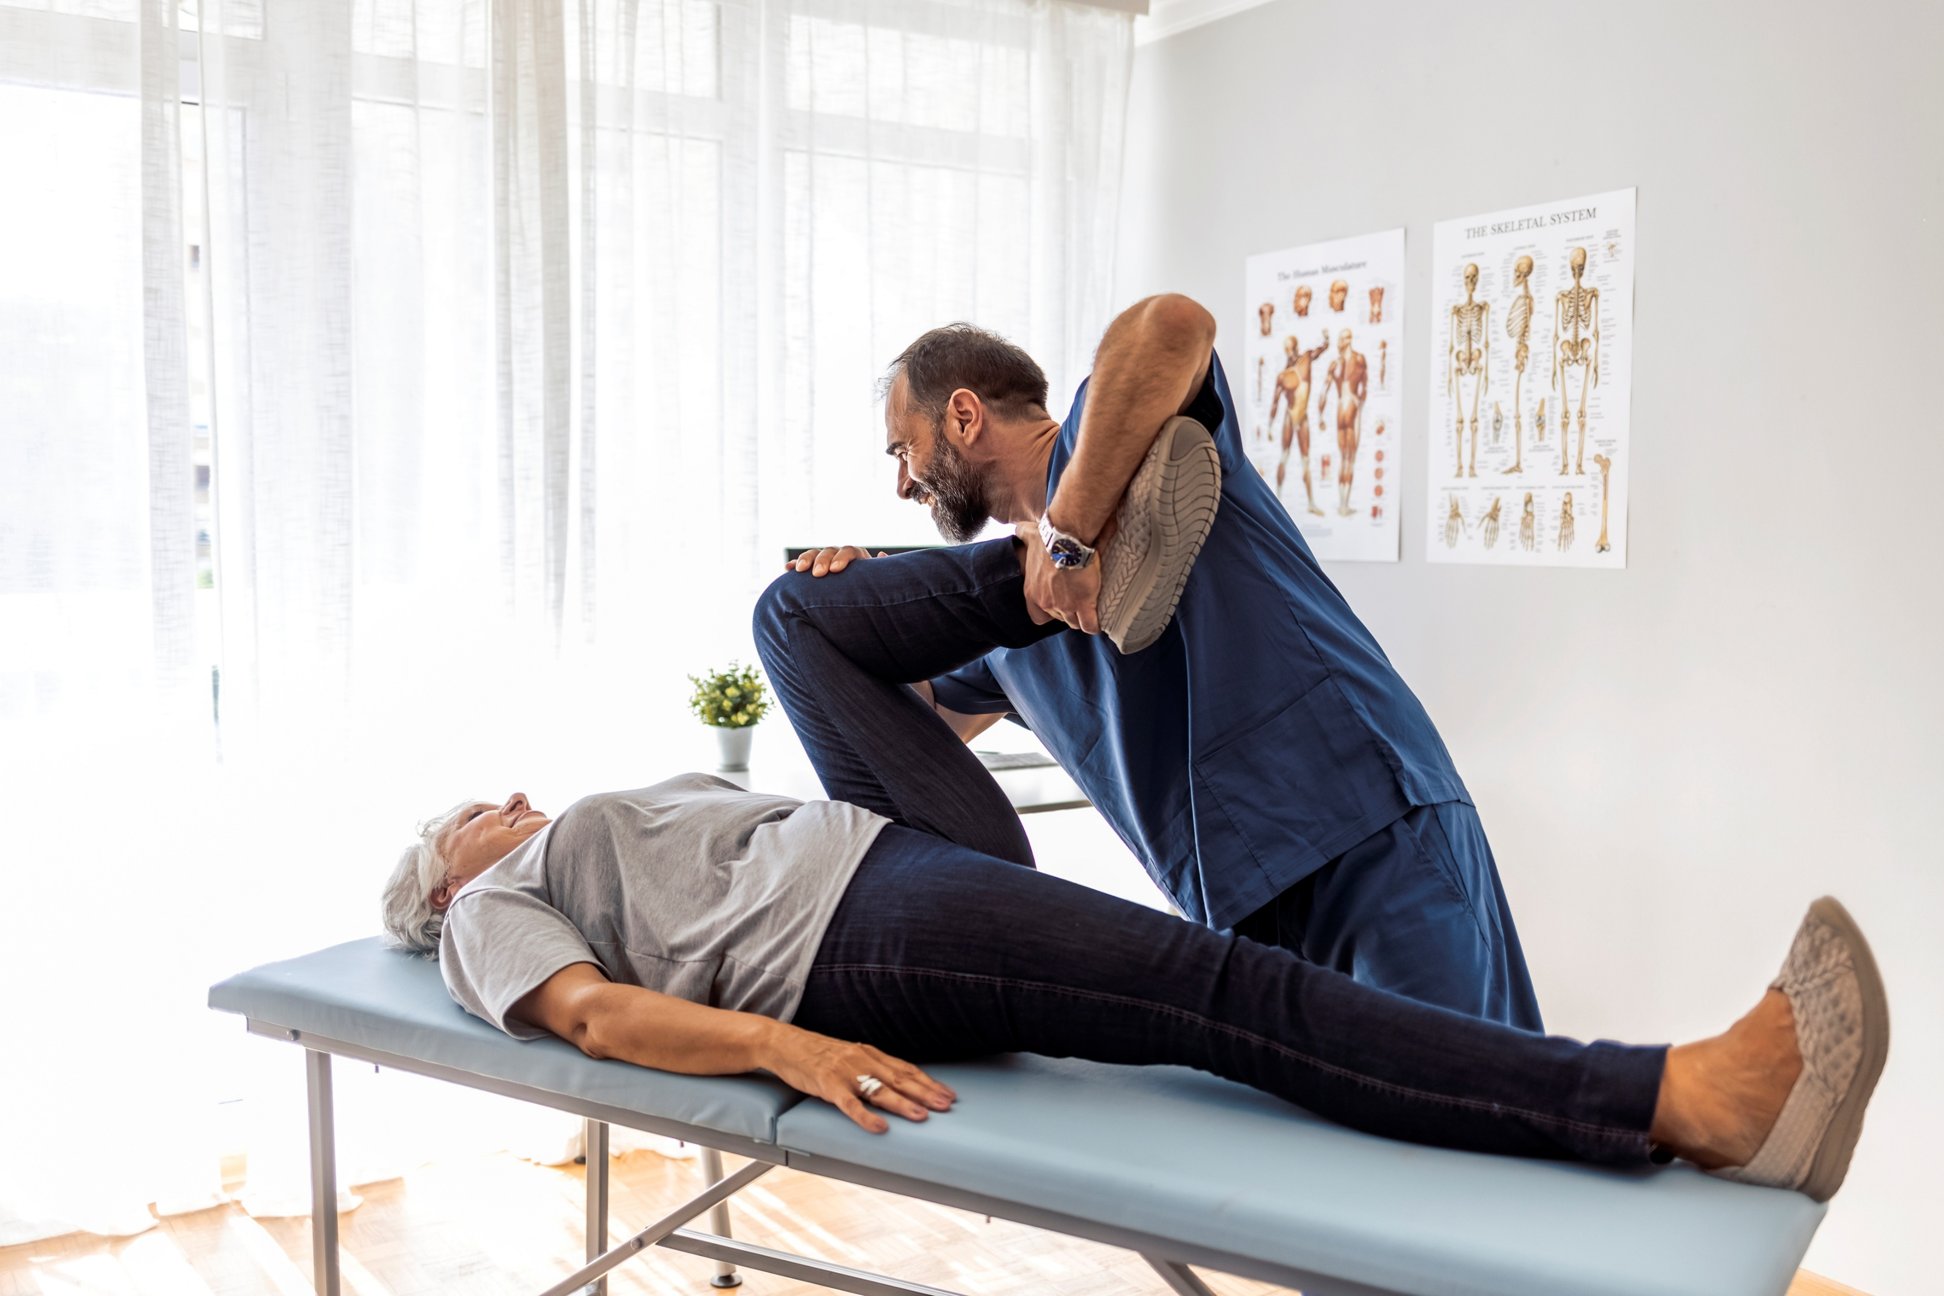
Brief advice and LBP outcomes
In low back pain, a single physio session with assessment and clear advice to stay active plus a written leaflet can:
  Produce similar long‑term outcomes (pain and disability) to multiple routine physiotherapy sessions
Notes:
A well‑delivered brief advice session can be as powerful as a longer course of treatment for many patients

Slide 16

Adherence, self‑management and outcomes
When patients understand why and how to exercise, they are more likely to adhere.
Better adherence is linked to:
  Reduced pain and stiffness
  Improved strength and daily function
So your public‑health role (education, coaching, problem‑solving barriers) is central to clinical outcomes

Slide 17

Prehabilitation: small dose, big impact
Short pre‑operative programmes (often a few physio sessions) that include:
  Targeted exercise
  Education and goal‑setting
  Behaviour‑change support
These programmes improve early post‑operative function after hip, knee and spine surgery compared with usual care

Slide 18
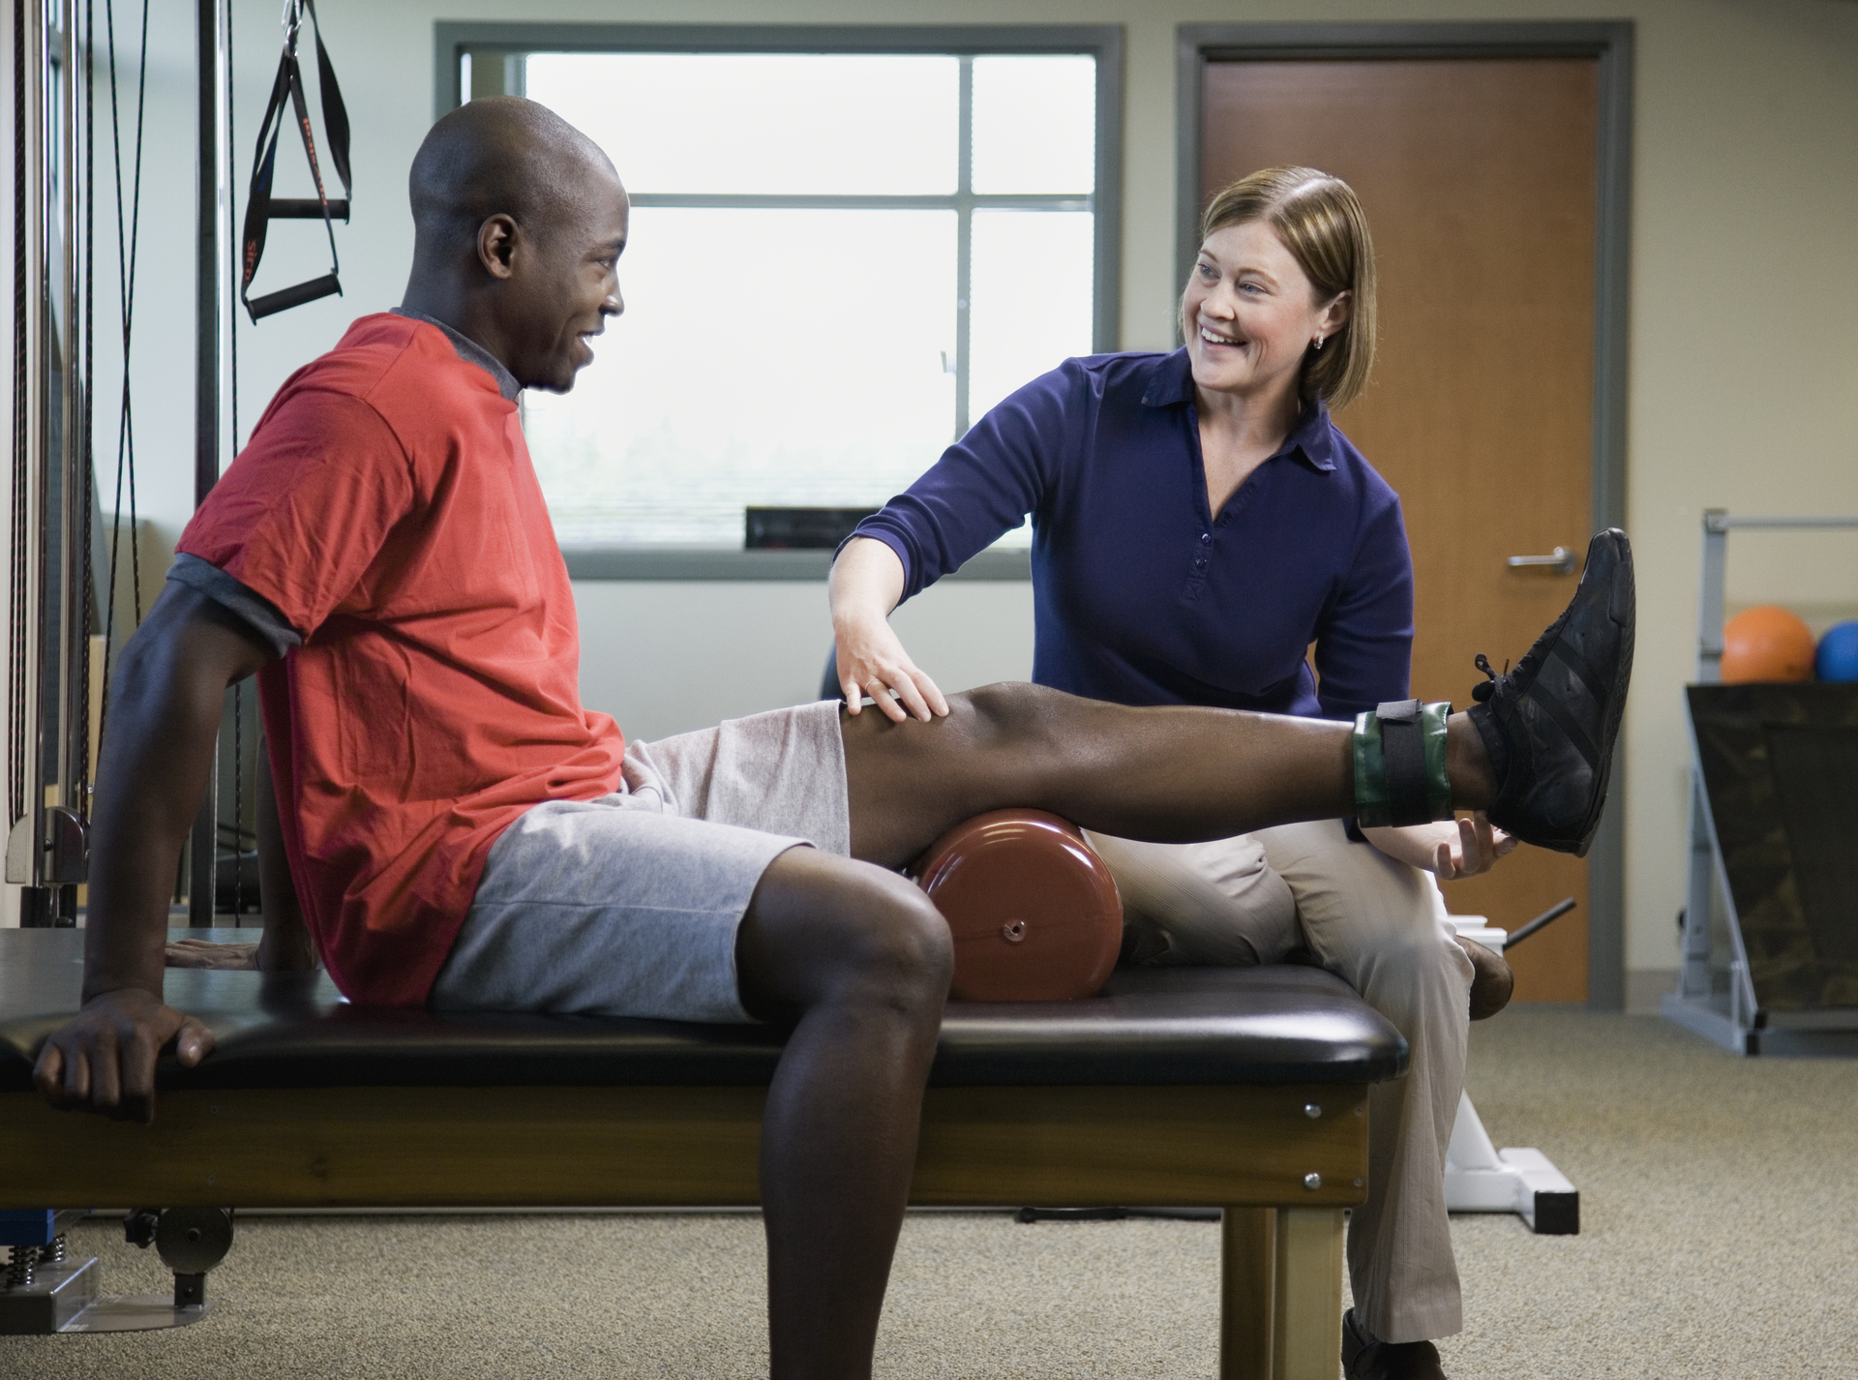
“Public health” in the surgical pathway
Your role is not just exercises after surgery:
  Before surgery: screen for smoking/inactivity, give brief advice, signpost support
  After surgery: reinforce activity guidelines, encourage safe progression and adherence
Each brief conversation is a chance to improve recovery and reduce complications

Slide 19
Activity and smoking cessation counselling in COPD
Brief physical‑activity counselling during or after PR focuses on:
  Setting realistic walking/step goals
  Problem‑solving barriers (fatigue, fear, environment)
Even when changes in daily step count are modest, counselling can help people sustain gains in confidence and exercise tolerance achieved in rehab
In COPD, patients who stop smoking and complete PR tend to:
  Walk further
  Have fewer exacerbations
  Report better quality of life
Brief smoking‑cessation conversations during physio contacts (Ask–Advise–Offer support) increase the chance that patients will attempt and maintain quitting

Slide 20

Key messages for practice
Brief, structured smoking‑cessation advice:
  More quit attempts and higher quit rates → better surgical and COPD outcomes
Brief, structured exercise advice aligned with guidelines:
  Better pain relief, function and recovery in MSK and post‑operative patients
These conversations are short, repeatable and fit naturally into physio contacts

Slide 21
Breaking down the HCPC jargon
"15.1 understand the role of their profession in health promotion, health education and preventing ill health".
Understand physio prevents problems occurring/worsening (exercise prevents falls, CVD risk).​
Health education = helping people understand condition + behaviour links (activity, smoking impact rehab).​
Routine opportunity-seeking = core competence

Slide 22
Breaking down the HCPC jargon
"15.2 understand how social, economic and environmental factors (wider determinants of health) can influence health/wellbeing".​
Social: caring responsibilities, isolation, cultural pain beliefs.​
Economic: low income, travel costs, insecure work.​
Environmental: unsafe neighbourhoods, poor housing, no green space.​
Same exercise programme won't work for everyone – adapt to real context.

Slide 23
Breaking down the HCPC Jargon
"15.3 empower and enable individuals (service users/colleagues) to play part in managing own health".​
Collaborative goal-setting vs imposing agenda.​
Self-management strategies (pacing, graded activity, flare-up plans).​
Community resource use (walking groups, online programmes) for sustained change.​
Small individual changes × many people = population impact

Slide 24
Linking in your SDL work
Pick one example where a physiotherapist was promoting health or preventing ill health.
In pairs, decide which HCPC Standards of Proficiency this example demonstrates
Example from my SDL: ___________________________
HCPC standards it links to:
  15.1 Health promotion / preventing ill health
  15.2 Wider determinants of health
  15.3 Empowering and enabling individuals
  Other (e.g. communication, partnership with service users)
Notes:
Individually, choose one example from your SDL where a physio was doing something that looks like public health – e.g. a falls class, smoking advice, activity promotion, education group.
Now, in pairs, answer: Which HCPC standards are being demonstrated here? Start with 15.1, 15.2 and 15.3, but you can add others (communication, partnership, evidence‑based practice).
After 2–3 minutes, take a few examples and map them out loud:
Example: “Pulmonary rehab with smoking‑cessation advice.”
You: “That clearly fits 15.1 (health promotion), 15.3 (empowering self‑management), and touches 15.2 if they tailored advice to what was realistic for that person.”
Example: “Community exercise group in a deprived area.”
You: “Again 15.1, plus 15.2 (wider determinants/inequalities).”
What you emphasise to them
“Notice that you’ve already found real‑world examples of physios meeting HCPC’s public‑health standards – this isn’t abstract.”
“The rest of today’s session (HCPC/CSP slides and MECC activity) is about making you more deliberate and confident in doing this yourselves on placement.”

Slide 25

Making every contact count (MECC)
MECC is about using routine health and care interactions to support people to make healthier choices.
It focuses on brief, opportunistic conversations about topics like smoking, physical activity, diet, alcohol and mental wellbeing.
Fits naturally into physio assessments and reviews

Slide 26
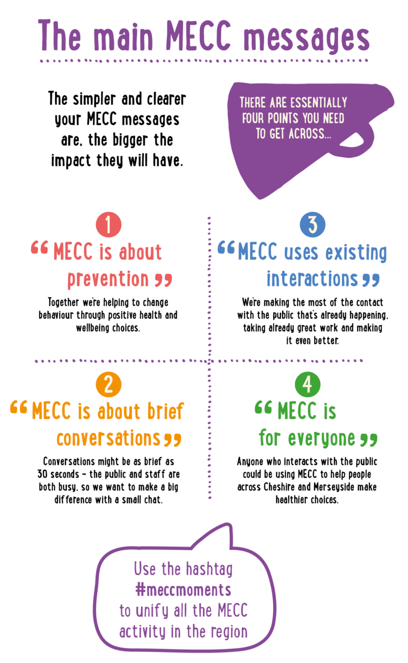
Key features of MECC
Person‑centred and non‑judgemental.
Brief (often 30 seconds to a few minutes).
Uses open questions to explore readiness and priorities.
Offers simple, realistic next steps and/or signposting.

Slide 27
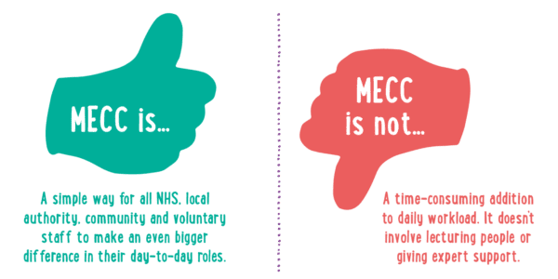
MECC and HCPC/CSP
Demonstrates HCPC standards on health promotion, wider determinants and empowering individuals.
Aligns with CSP’s emphasis on health‑promoting practice and behaviour change skills.
A practical way to show, on placement, that you understand your public‑health role.

Slide 28
MECC role play
“Designing a brief health‑promoting conversation”
Work in groups of 3–4.
Each group receives a short case scenario.
Your task: choose one behaviour‑change opportunity and plan a 3–4 line MECC‑style conversation.
You will then link your conversation back to specific HCPC standards.

Slide 29
Task breakdown
Step 1: Identify one main public‑health focus (e.g. smoking, physical activity, falls risk, weight management).
Step 2: Draft a 3–4 line conversation that:
  Asks permission to talk about it.
  Uses at least one open question.
  Offers one realistic next step or signpost (e.g. local service, leaflet, website).
Step 3: Under your script, list the HCPC standards you think you are meeting (e.g. 15.1, 15.2, 15.3; communication; partnership with service users).

Slide 30
Case A
“45‑year‑old warehouse worker with recurrent low back pain.
  Smokes 10–15 cigarettes/day.
  Reports very little physical activity outside work.
  BMI in the obese range.
  Worried about taking time off for exercises.”
Prompt: “Which behaviour would you focus on in this contact? Why?”

Slide 31
Case B
“60‑year‑old with COPD referred to pulmonary rehab.
  Breathless walking to the shops.
  Anxious about exercise worsening breathlessness.
  Unsure about attending group sessions.”
Prompt: “How could you use a brief conversation to promote confidence and physical activity?”

Slide 32
Case C
“55‑year‑old post‑stroke, now at home.
  Spends most of the day sitting.
  Says they ‘don’t know where to start’ with activity.
  Feels embarrassed about going out alone.”
Prompt: “What small, realistic next step could you help them identify?”

Slide 33
Reflection
“What worked well in that conversation?”
“How might the person feel hearing that?”
“What might get in the way of doing this on placement?”
“What could help?”

Slide 34

Key take-home messages
Physiotherapists are part of the public health workforce, not just “treatment providers”.
HCPC and CSP expect you to promote health, understand wider determinants and empower patients.
MECC‑style brief conversations are a practical way to live out these expectations in day‑to‑day practice.

Slide 35
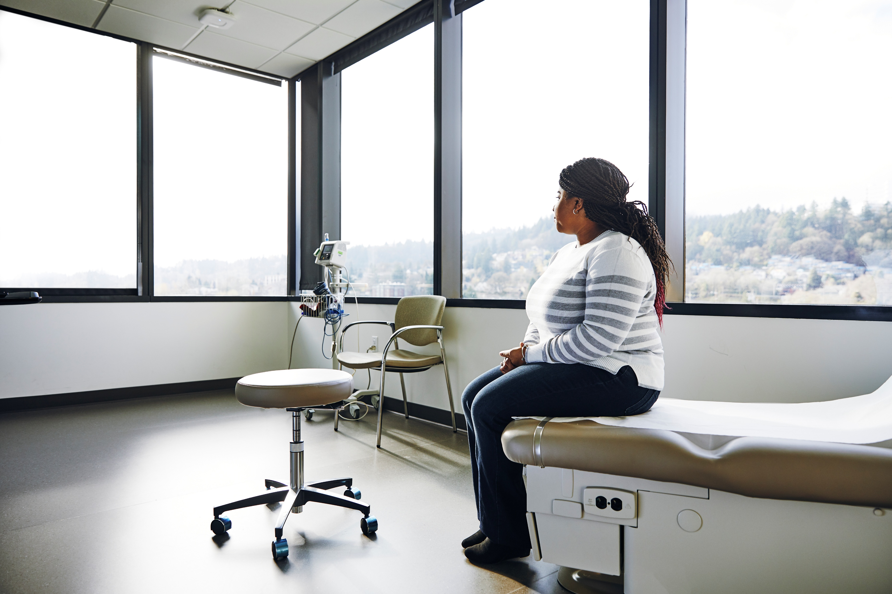
From classroom to placement
Asking about activity levels and collaboratively setting one extra‑walk goal.
Briefly raising smoking or alcohol if relevant to rehab and offering signposting.
Adapting advice to the person’s social and environmental context.

Slide 36
Final reflection
“After today’s session and your SDL, what is ONE concrete action you could take on your next placement to ‘make every contact count’ as a physiotherapist?”

Slide 37
References
HCPC and CSP Standards
Health and Care Professions Council (HCPC). (2023). Standards of proficiency: Physiotherapists. Available at: https://www.hcpc-uk.org/standards/standards-of-proficiency/physiotherapists/ [Accessed 18 March 2026].
Chartered Society of Physiotherapy (CSP). Physios say… Physiotherapy: promoting and improving public health and wellbeing. Available at: https://www.csp.org.uk [Accessed 18 March 2026].
Evidence: Pain and MSK Outcomes
Frost, H., Lamb, S.E., Doll, H.A., Carver, P.T. and Stewart-Brown, S. (2004). Randomised controlled trial of physiotherapy compared with advice for low back pain. BMJ, 329(7468), p.708.
Sandborgh, M., Lindell, M., Dannapfel, P., Almqvist, L., Rutberg, H. and Eskilsson, T. (2021). Physiotherapist‑led rehabilitation for patients with chronic musculoskeletal pain. BMC Musculoskeletal Disorders, 22(1), p.12.
Evidence: Smoking Cessation and Exercise
Wang, D., Wang, P., Lan, K. and Zhang, Y. (2023). Effect of exercise intervention on smoking cessation: a meta‑analysis. Frontiers in Physiology, 14:1221898.
Evidence: Making Every Contact Count (MECC)
Andy, U., Ogunbayo, O.J., Clifford, R., Bull, E. and Peckham, E. (2025). Increasing confidence and competence in supporting behaviour change in physiotherapy practice using Making Every Contact Count Healthy Conversation Skills: a before and after evaluation. Musculoskeletal Science and Practice, 75, 103227.
Evidence: Surgical Outcomes and Prehabilitation
Moyer, R., Ikert, K., Long, K. and Marsh, J. (2023). Prehabilitation for patients undergoing orthopedic surgery: a systematic review and meta‑analysis. JAMA Network Open, 6(4), e2239938.
Evidence: COPD, Pulmonary Rehabilitation and Exercise Tolerance
Foglio, K., Bianchi, L., Bruletti, G., Battista, L., Pagani, M. and Ambrosino, N. (2009). Effects of pulmonary rehabilitation on exercise capacity in patients with COPD: a number needed to treat analysis. International Journal of COPD, 4, pp.315–319.
Burtin, C., Langer, D., van Remoortel, H., Demeyer, H., Gosselink, R., Decramer, M. and Troosters, T. (2015). Physical activity counselling during pulmonary rehabilitation in patients with COPD: a randomised controlled trial. PLOS ONE, 10(12), e0144989.
Evidence: Physiotherapy and Public Health Strategy
Physiotherapy – an effective but underutilized strategy for strengthening public health. (2025). International Journal of Translational Medical Research and Public Health, 9(1).

